Slide 1
PDX 2045 Planning Advisory Committee
Meeting 7
May 19, 2025
Notes:
Suzanne

Slide 2
INTRODUCTION
Agenda
Time | Topic
5:30 PM | Welcome, Meeting Goals, and PAC 6 Recap
5:35 PM | What’s New at PDX
5:50 PM | Public Comment
5:55 PM | Preliminary Airfield and Terminal Alternatives
6:15 PM | Interactive Exercise Part 1 (breakout activity)
6:30 PM | Break
6:45 PM | Interactive Exercise Part 2 (breakout activity)
7:15 PM | Open Discussion (return to Chinook)
7:40 PM | Landside Requirements
7:55 PM | PAC Next Steps
8:00 PM | Adjourn

Slide 3
INTRODUCTION
Meeting goals
Review airfield and terminal alternatives
Conduct “red dot, green dot” evaluation of alternatives
Preview access, parking, and transit requirements
Notes:
Remind people about meeting logistics
Community members listening in, you can use the Zoom chat to submit questions or comments. We may not be able to answer questions, but they will be part of the meeting record. Community members (online or in person), we ask that except for public comment and unless otherwise noted, you engage in an observer role.

Slide 4
PAC 6 Recap
Notes:
Aaron

Slide 5
PAC 6 RECAP
We learned what’s important to you when considering terminal alternatives…
constraints regarding space
possible noise impacts
walking distance
sense of place
efficiency
user friendly
ease
cost
cost comparison
efficient
cost effective
access
culture-rich approach
centralized
utilizing main terminal
space below
great experience
proximity of baggage claim
distance
less walking
other pick up-drop off
space limitations

Slide 6
PAC 6 RECAP
…and we gathered your perspective on the International Arrivals Facility.
How would you size the IAF?
Where would you expand the IAF?
17
11
6
5
5
0
Keep as is
Large enough for anticipated demand
Shoot for the moon!
Expand the existing location
Concourse E
Somewhere else

Slide 7
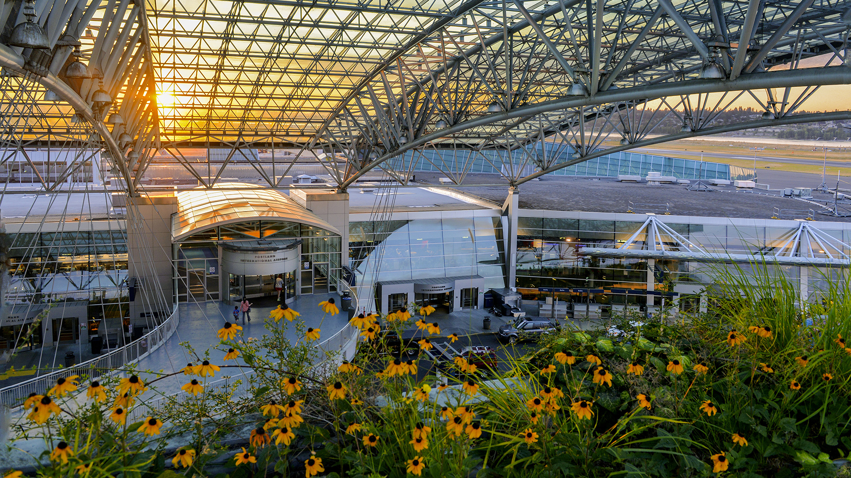
What’s new at PDX?
Dan Pippenger
Chief Aviation Officer

Slide 8
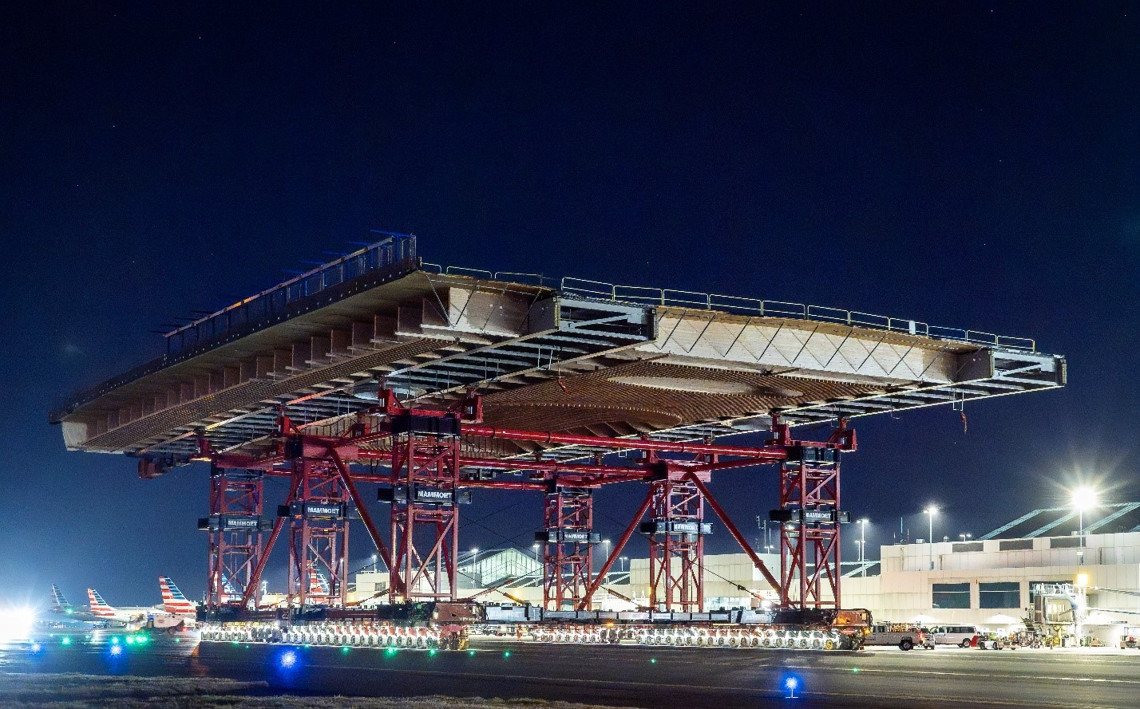
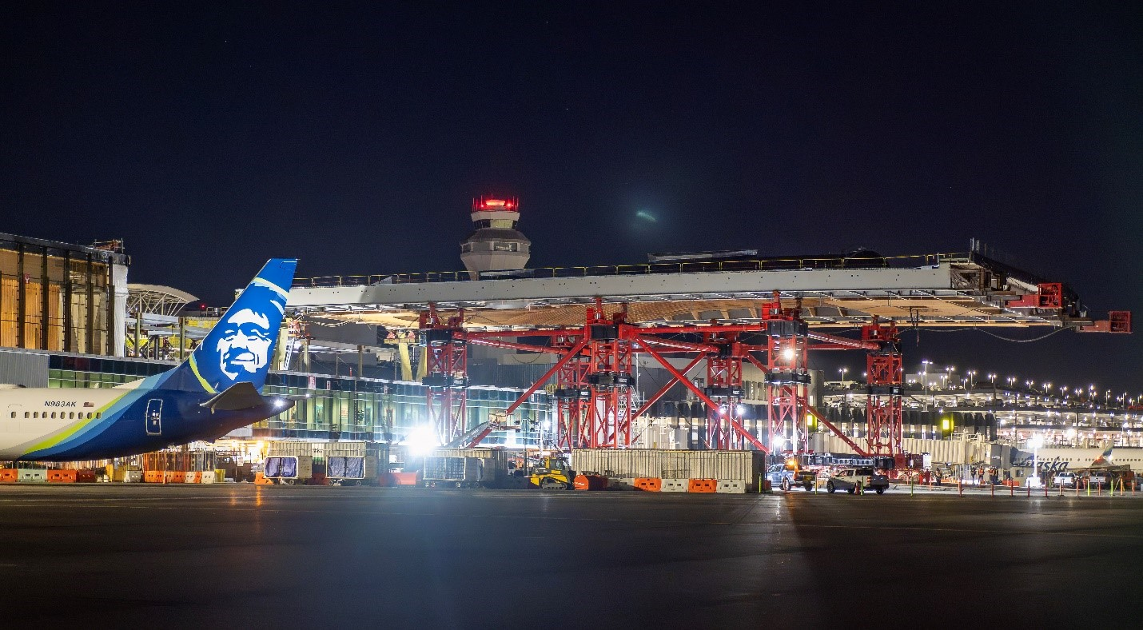
Roof module installation

Slide 9
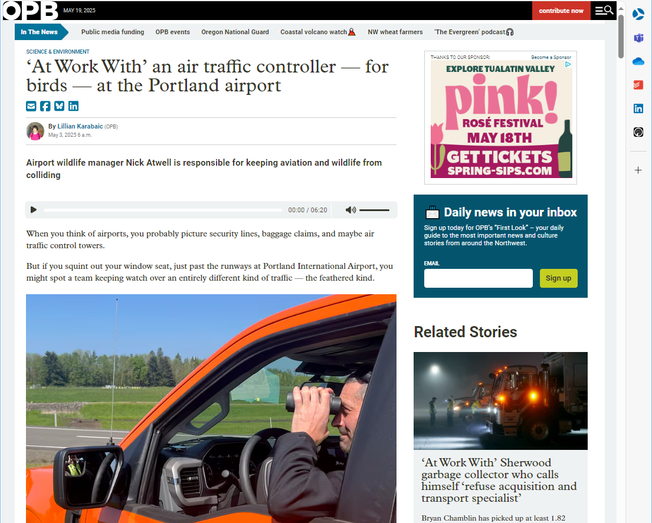

Slide 10
Public Comment
Notes:
Suzanne

Slide 11
Public comment
ZOOM INSTRUCTIONS
Add your full name to the Q&A box if you want to comment
The facilitator will call your name when it is your turn to speak
When your name is called, there will be a brief pause as Zoom removes and reintroduces you to the meeting as a “Panelist”
When you return, please unmute your audio and start video before speaking
When your time is complete (3 minutes), you will be reassigned as an “Attendee”

Slide 12
Preliminary Airfield and Terminal Alternatives
Notes:
Cameron

Slide 13
PRELIMINARY AIRFIELD AND TERMINAL ALTERNATIVES
Preliminary observations
Location of the international arrivals facility (IAF) is a key driver of future alternatives
Airfield: Large aircraft gate and access requirements
Terminal: International inspection spaces, sterile circulation, holdroom, and amenities requirements
Landside: Non-secure access
North terminal areas provide greater opportunity for accommodating growth
Most available area for growth
Most significant deficiencies of existing facilities
Least resilient / oldest infrastructure
South terminal areas provide opportunity for enhancement of existing facilities

Slide 14
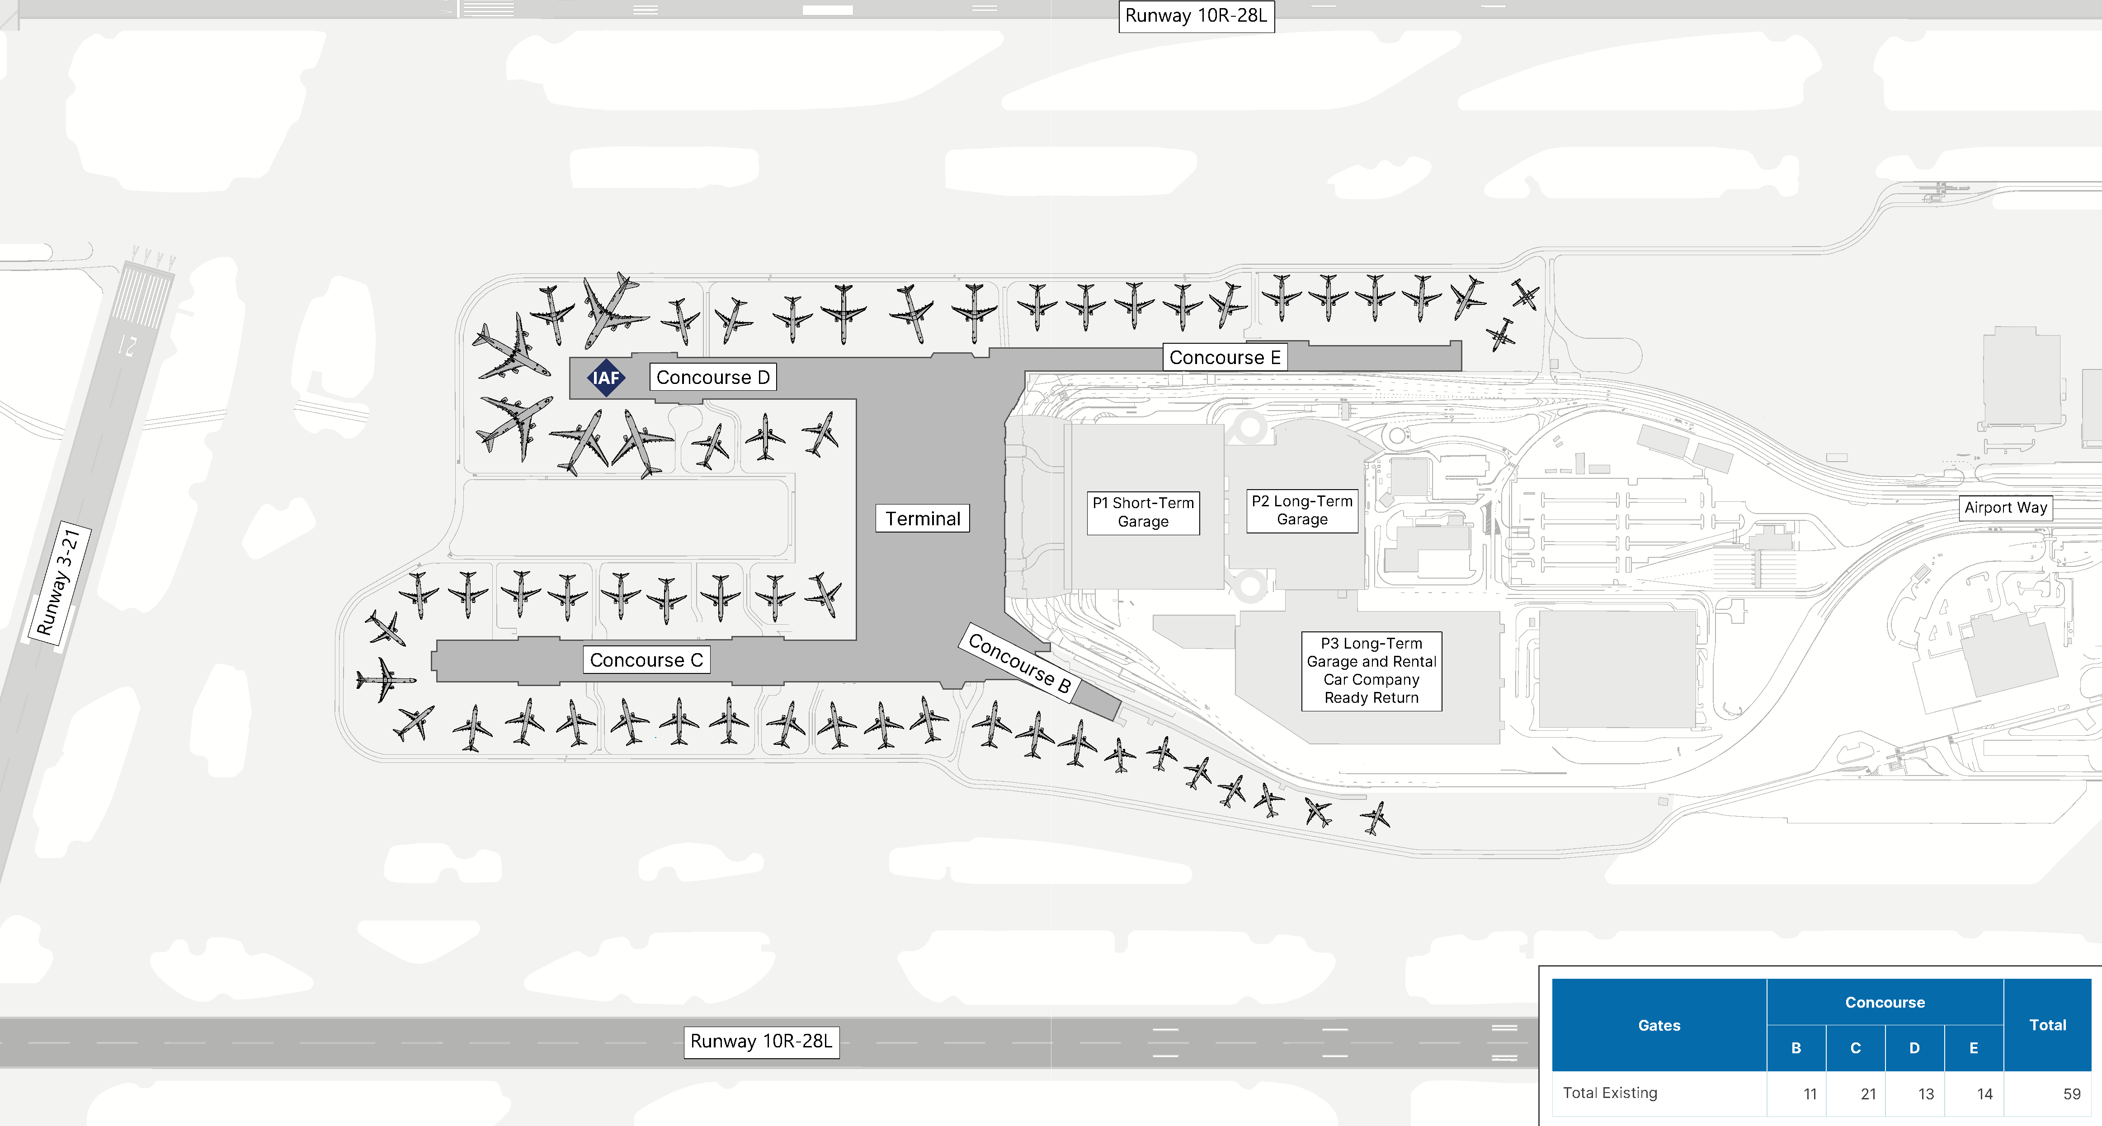
Existing conditions

Slide 15
Existing conditions
New Facility / High Resiliency
Aging Facility / Less Resilient
Old Facility / No Resiliency

Slide 16
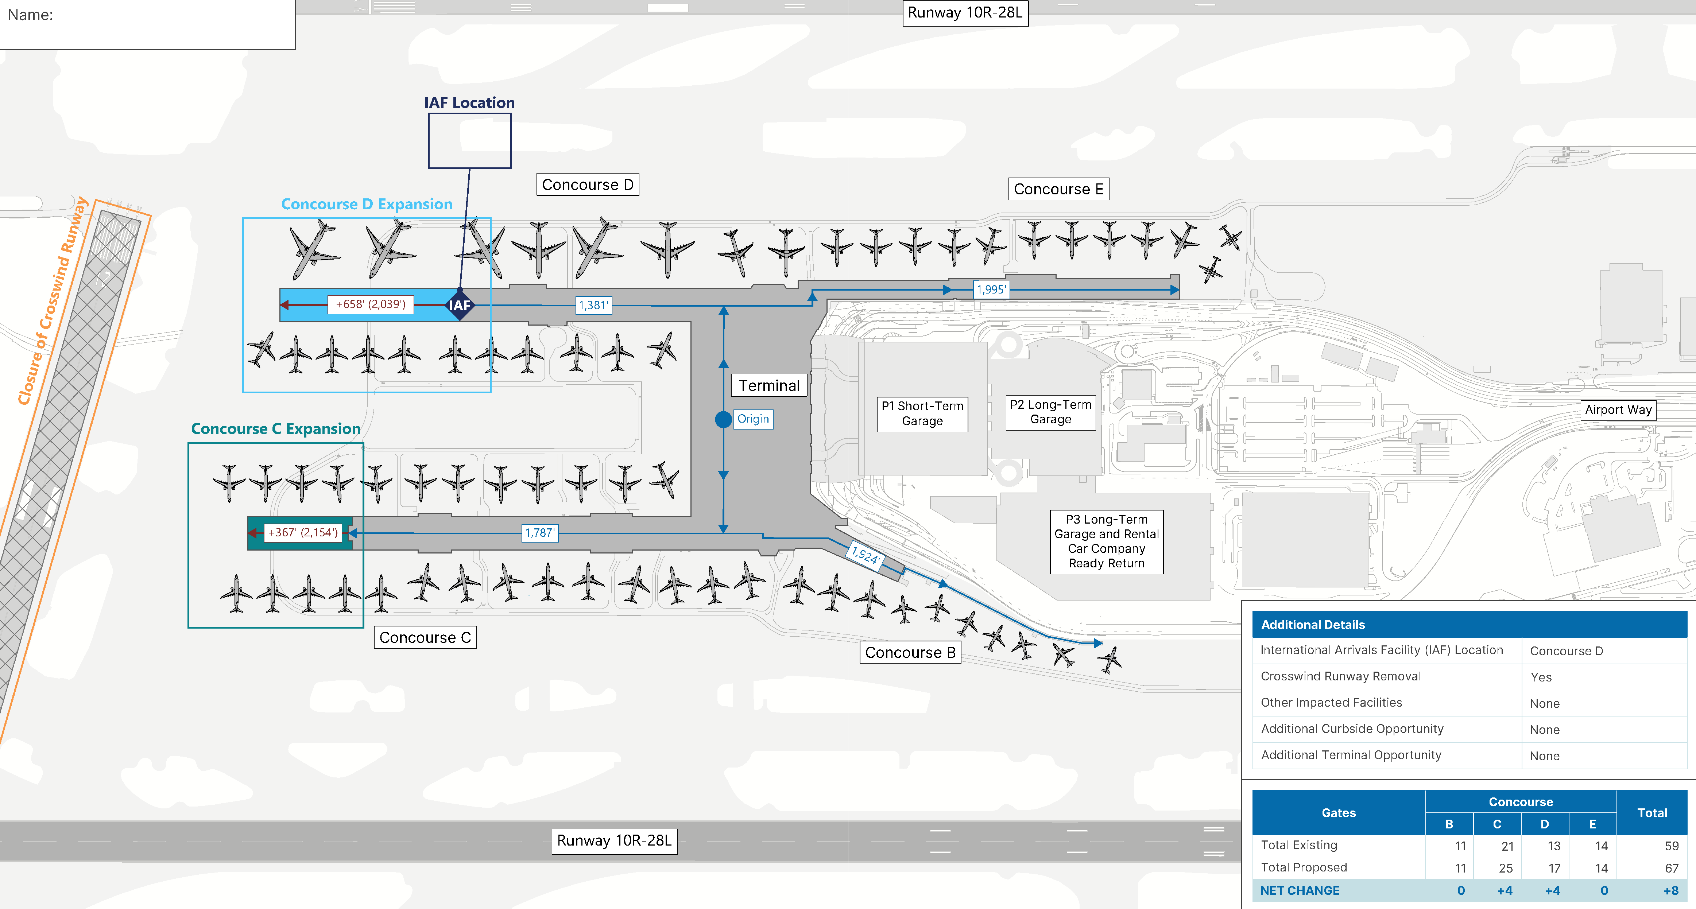
Concourses C and D expansion

Slide 17
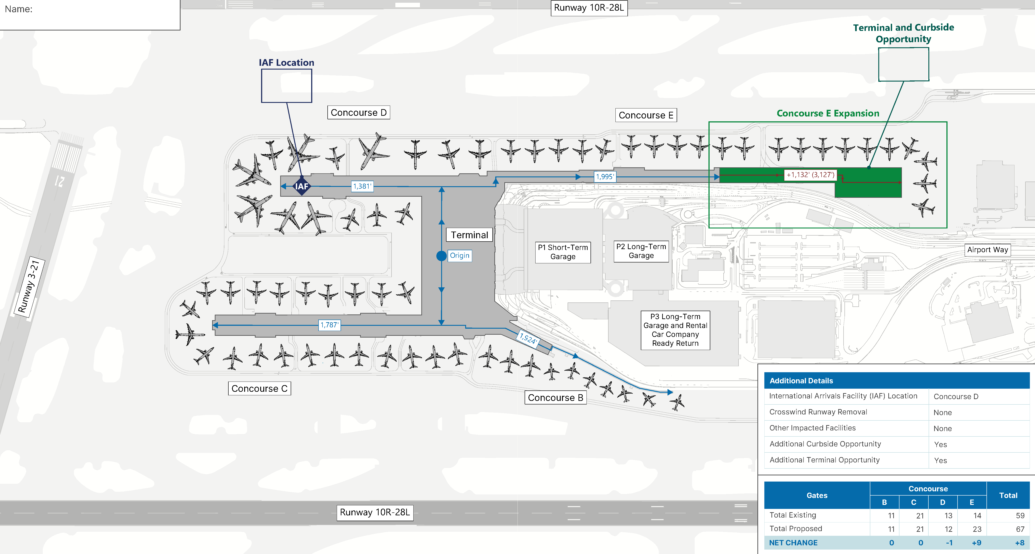
Concourse E expansion
Terminal and Curbside Opportunity

Slide 18
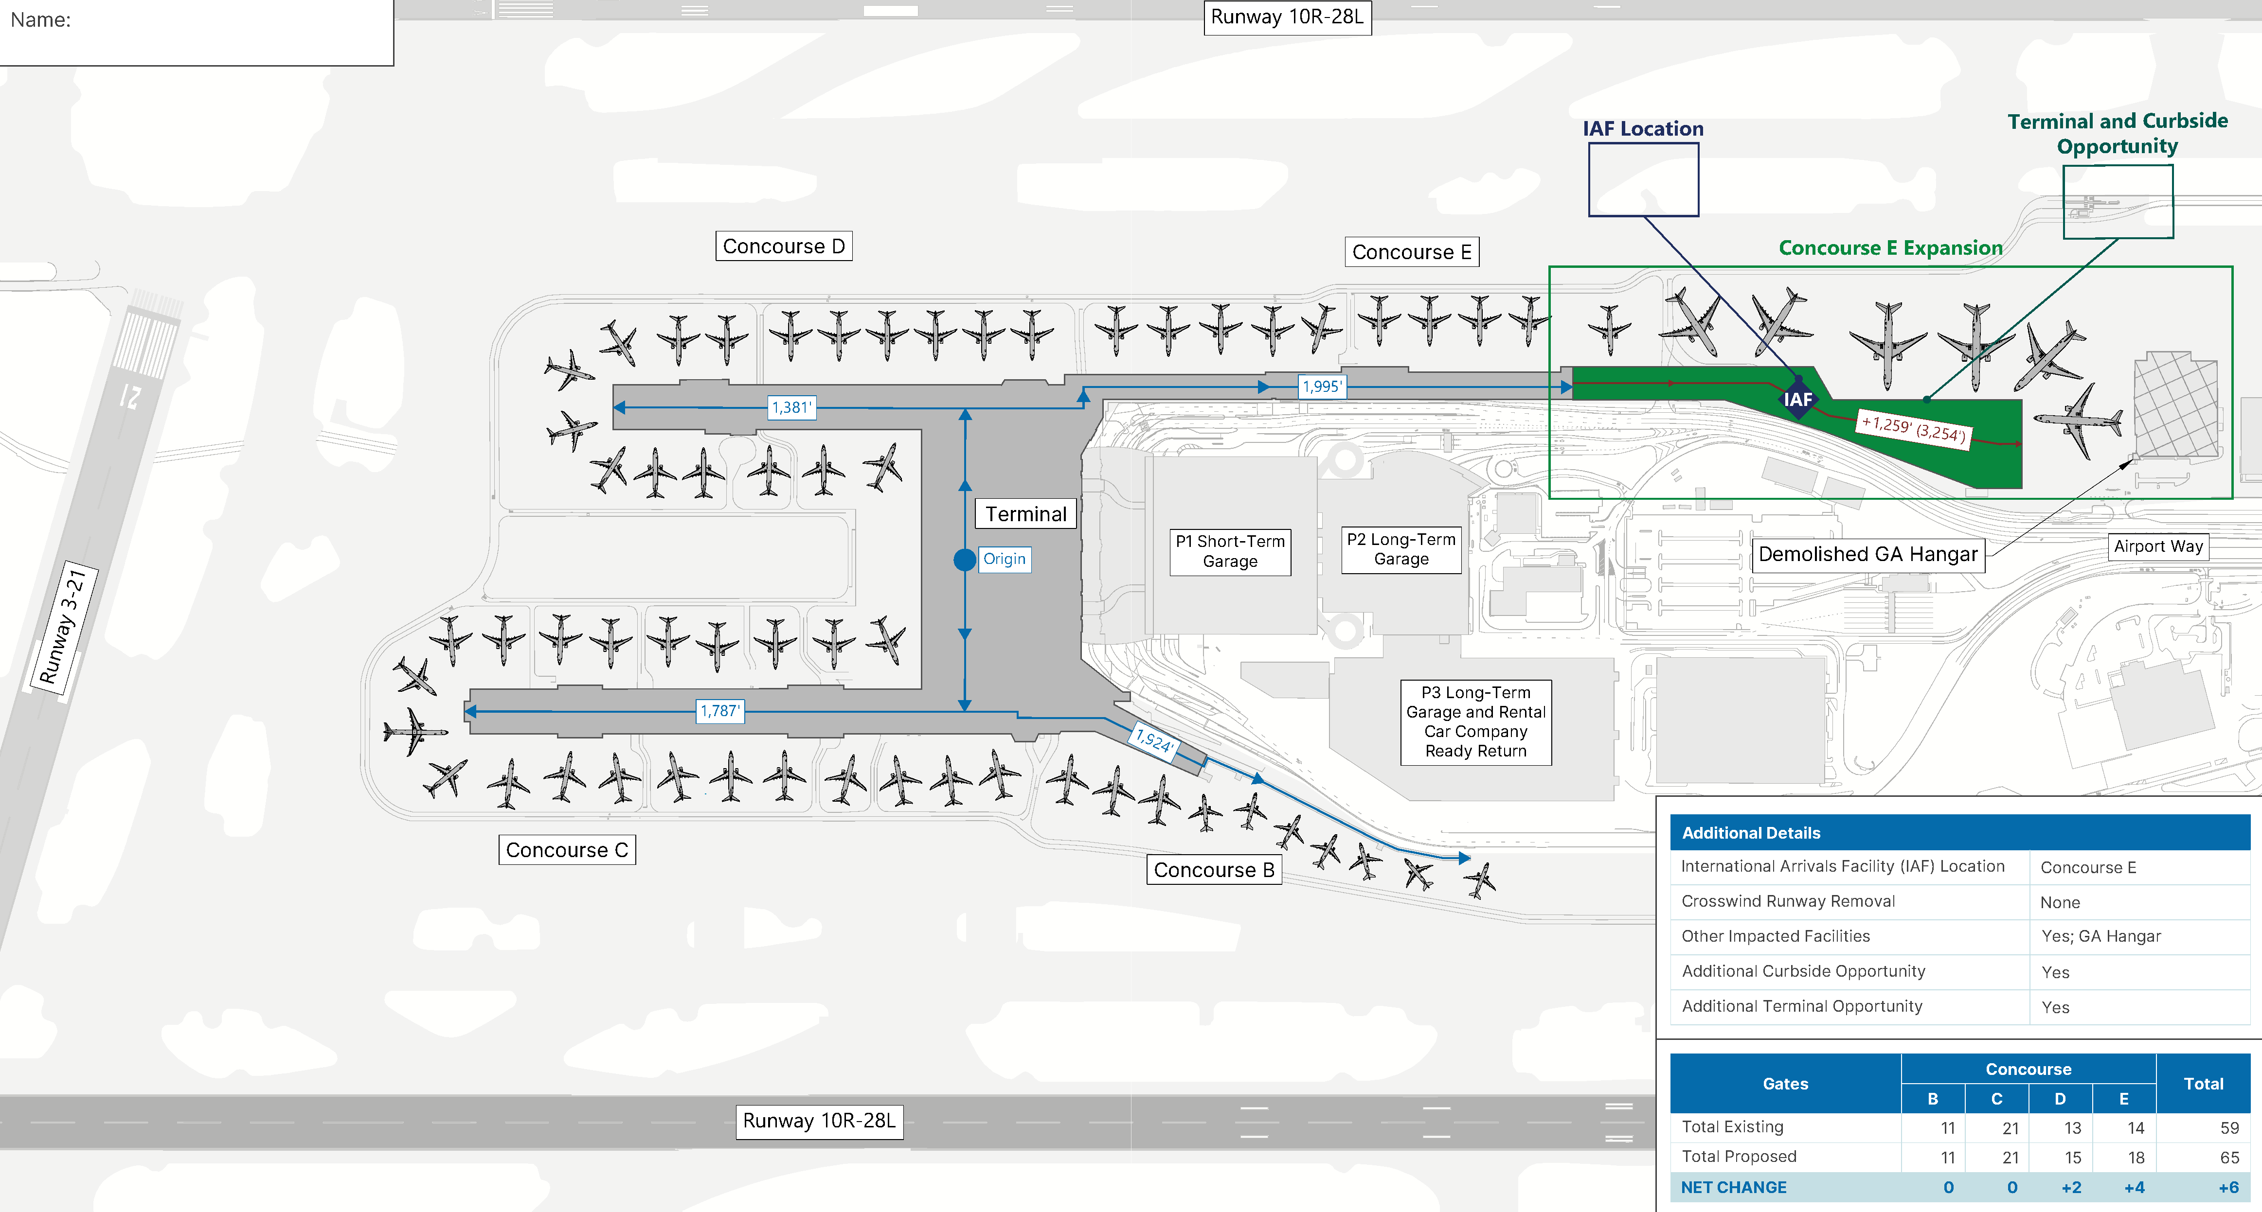
Concourse E expansion with IAF

Slide 19
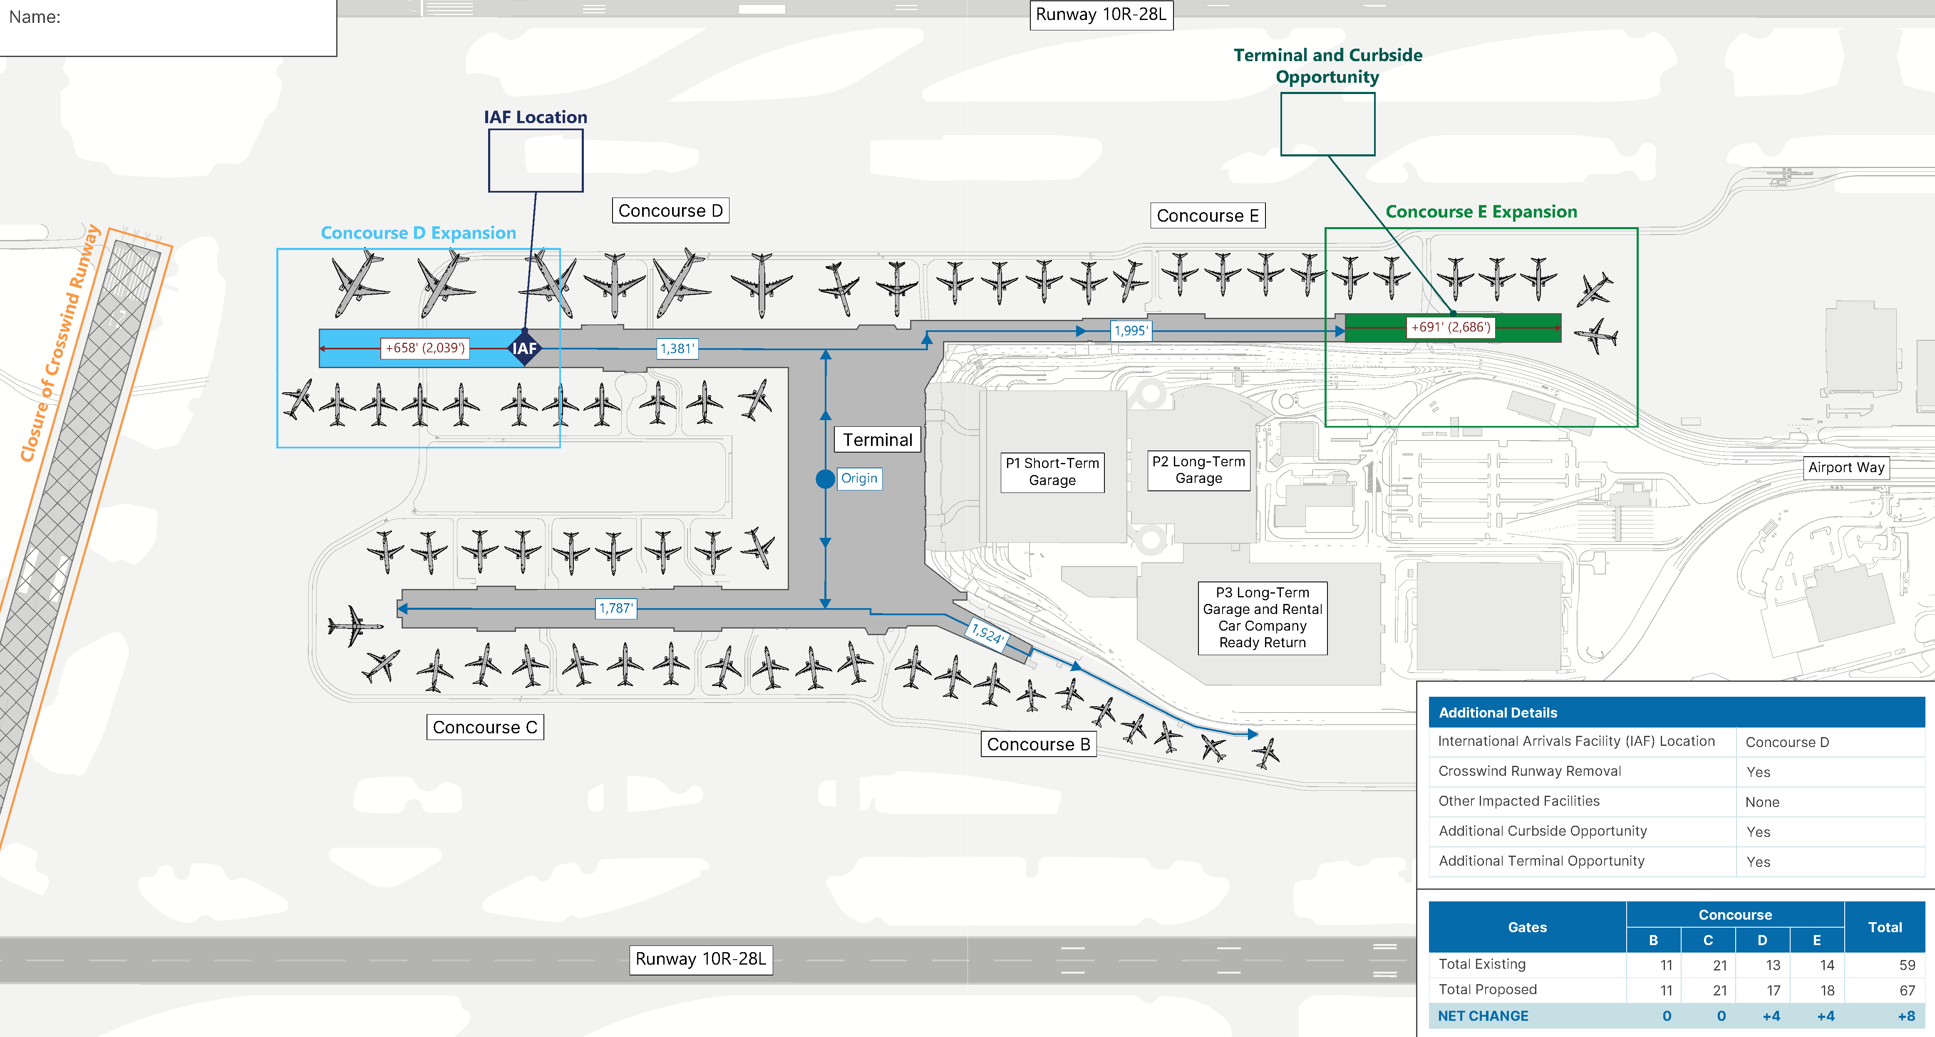
Concourses D and E expansion
Terminal and Curbside Opportunity

Slide 20
Interactive Exercise
Notes:
Cameron

Slide 21
INTERACTIVE EXERCISE
Red dot, green dot (individual)
Time: 15 minutes
Materials:
One alternatives packet or Google slide deck per person
30 red and green dots per person
Instructions:
There are 4 alternatives (one per page/google slide)
Place one dot for every major facility element based on whether you like or dislike that proposed facility element
Be prepared to talk about your reasoning for each dot
Example:
A few tips!
Recall the trade-offs we discussed in the last PAC meeting.
Need more information? Ask a project team member!
IAF
Notes:
Remind PAC members that this exercise should be from their own perspective

Slide 22
Break
Notes:
Suzanne announces the break and Aaron announces Evan’s departure

Slide 23
INTERACTIVE EXERCISE
Red dot, green dot (group)
Time: 30 minutes
Materials:
4 large alternatives prints or Google slide deck per group
30 red and green dots per person
Instructions:
Get into groups (assigned by the planning team)
Go through each alternative’s facility elements with your group and discuss which dot you chose before and what your reasoning was
Each person will again place one dot for every major facility element
Return to Chinook at 7:15 PM
A few tips!
Consensus is not required!
Be open to others’ reasoning and change your vote only if you feel that you have a different perspective after hearing the group’s thoughts.

Slide 24
INTERACTIVE EXERCISE
Open discussion
1.
What was your group’s preferred alternative? Why?
2.
Were there any disagreements amongst your group?
3.
If there was one element you would add to your preferred alternative, what would it be?

Slide 25
Overview of Landside Requirements
Notes:
Cameron

Slide 26
OVERVIEW OF LANDSIDE REQUIREMENTS
Requirements summary
Airfield Requirements
Terminal Requirements
Landside Requirements
Other Requirements
Notes:
Why airfield – terminal – landside – everything else

Slide 27
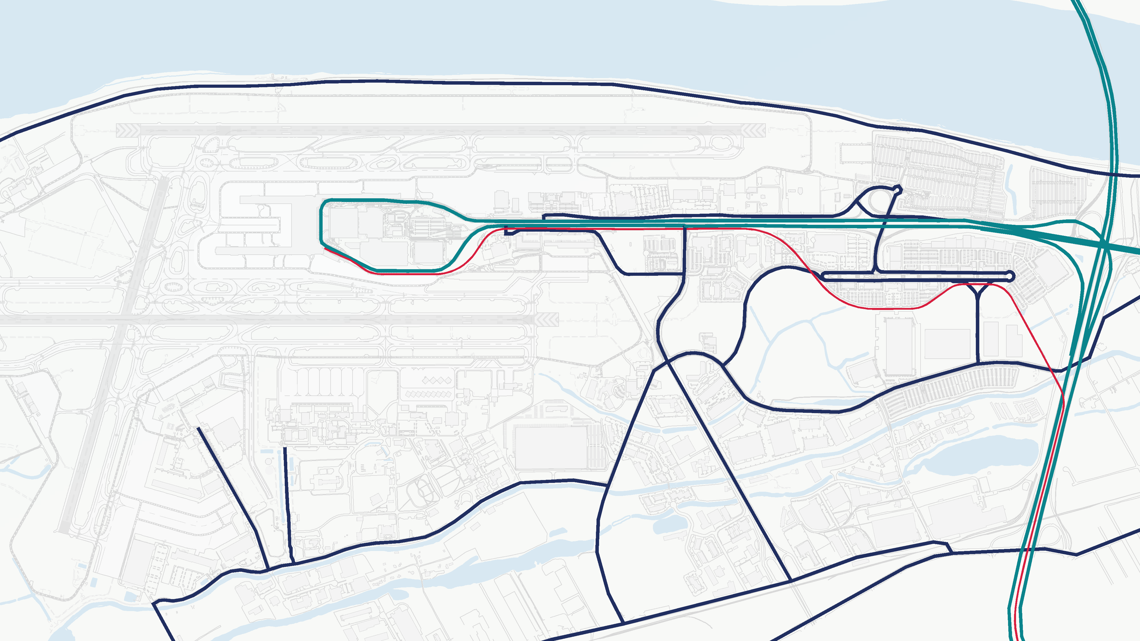
OVERVIEW OF LANDSIDE REQUIREMENTS
Landside roadways
NE Marine Dr
PRIMARY ACCESS
Terminal
NE Airport Way
Frontage Rd
NE Mt
Hood Ave
OTHER ACCESS
NE Air
Cargo Way
NE Cascade Pkwy
MAX Red Line Station
NE Mt St
Helens Ave
NE Holman St
MAX Red Line
NE Alderwood Rd
NE Alderwood Rd
NE Mary Olsen Way
NE 82nd Ave
NE Airtrans Way
NE Cornfoot Rd
Sandy Blvd
NE 47th
Ave
NE Columbia Ct
NE Lombard St

Slide 28
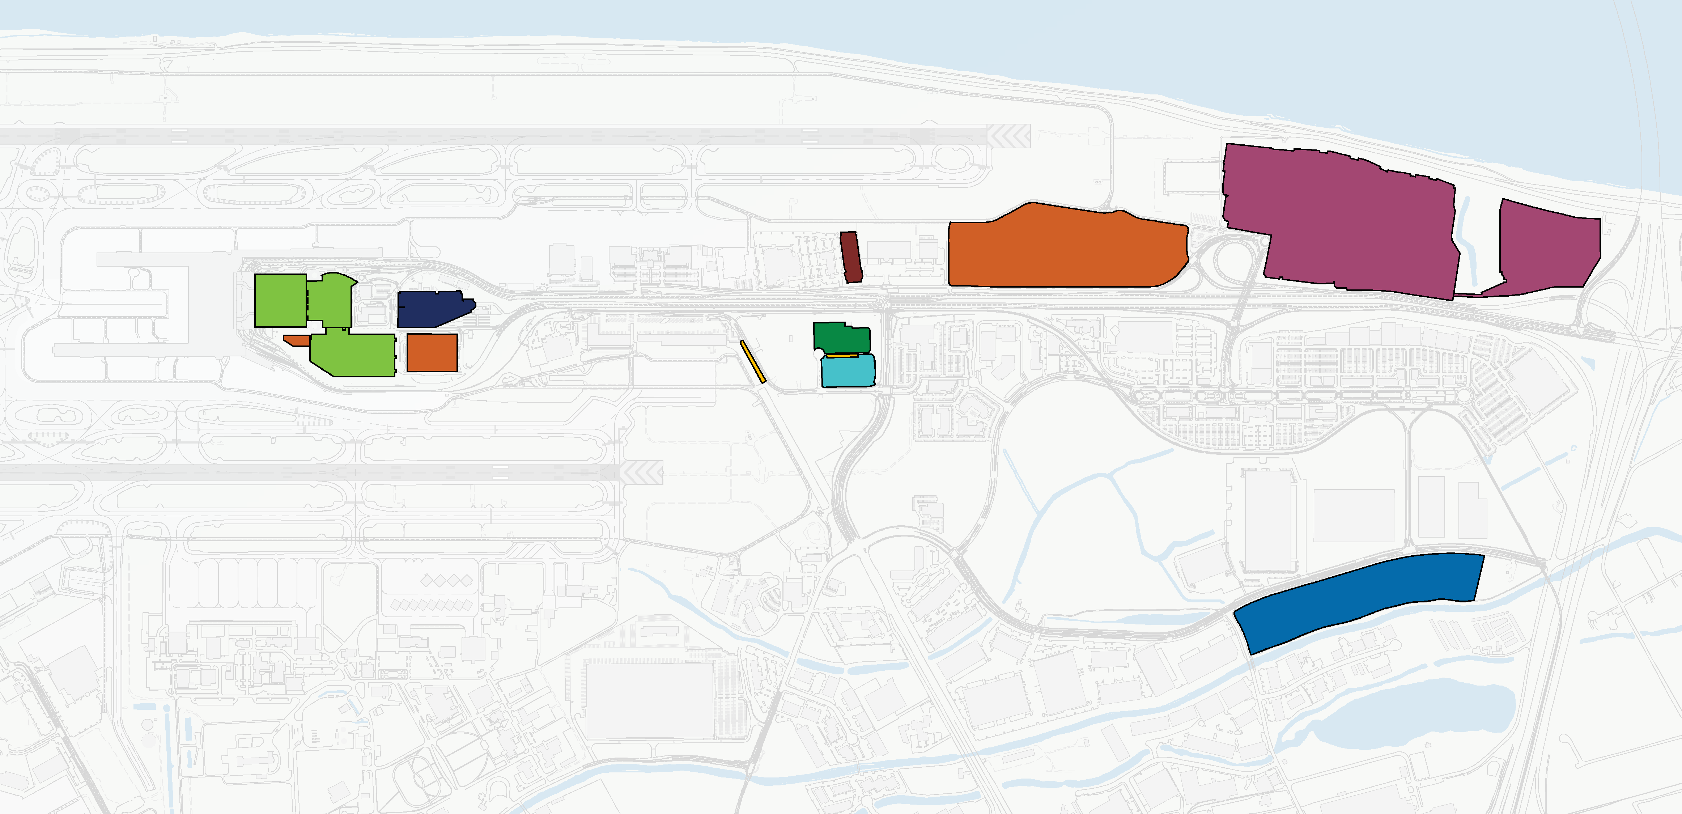
OVERVIEW OF LANDSIDE REQUIREMENTS
Landside facilities
Economy Lots
Rental Car Storage
Valet
Storage
P1 Garage
Port Employee Surface Lot
P2 Garage
Ground Transportation Hold Lot
Terminal
NE Airport Way
PDX Travel Center
Cascade Station
Valet
Rental Car Center
Rental Car Quick-Turnaround Area
Cell Phone Lots
Cell Phone Lots
P3 Garage and Rental Cars
Alderwood PDX Employee Lot

Slide 29
OVERVIEW OF LANDSIDE REQUIREMENTS
Preliminary requirements summary
 | Preliminary Assessment
Landside Facilities | 2030 | 2035 | 2040 | 2045
Airport Way westbound, west of 82nd
Airport Way eastbound, west of 82nd
Curbsides
Commercial vehicle facilities
Public parking
Employee parking
Rental car area
 | Optimum Sub-Optimum
LEGEND

Slide 30
OVERVIEW OF LANDSIDE REQUIREMENTS
Historical activity per passenger, selected modes
12%
10%
8%
6%
4%
2%
0%
NOTE:
TNC – Transportation Network Company (e.g. Uber, Lyft)

Slide 31
OVERVIEW OF LANDSIDE REQUIREMENTS
Landside considerations
Several factors drive landside facility needs
Peak period activity
Port policy decisions
Mode choice trends
What are your priorities for landside?
Reliability?
Proximity to the terminal?
Easy access?
Choice?

Slide 32
Next Steps
Notes:
Suzanne

Slide 33
NEXT STEPS
Work plan
PAC meeting | Meeting topics | Date
1 | Welcome and background | May 20, 2024
2 | Baseline forecast & preliminary facilities requirements | July 16, 2024
3 | Facility tour | Sept 19, 2024
4 | Functional area alternatives and requirements | Oct 21, 2024
5 | Functional area alternatives and requirements | Jan 15, 2025
6 | Functional area alternatives and requirements | Mar 17, 2025
7 | Functional area alternatives and requirements | May 19, 2025
8 | Landside requirements and consolidated alternatives | July 15, 2025
9 | Preferred alternative(s) | Sept 16, 2025
10 | Preferred alternative and implementation | Nov 12, 2025
11 | Ongoing engagement | ~ Jan 2026
12 | Wrap-Up | ~ Feb 2026
>

Slide 34
Thank you for your participation!
Please take our meeting evaluation survey
bit.ly/PAC_7

Slide 35
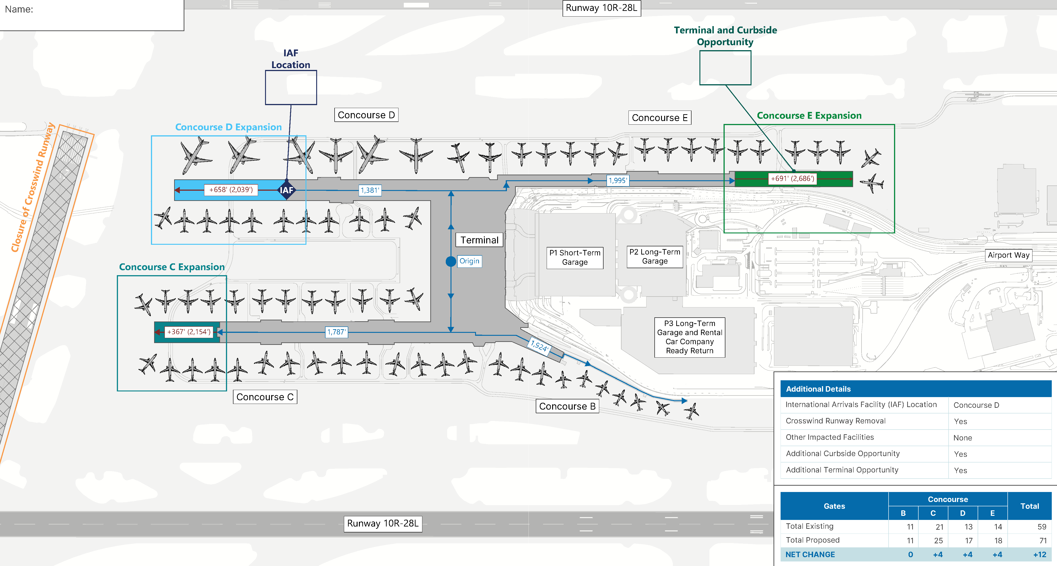
Concourses C, D, and E expansion
Terminal and Curbside Opportunity

Slide 36
ACCESS, PARKING, AND TRANSIT
Summary
Existing
High Impact Scenario
Low Impact Scenario
TNC’s take 11% of originating enplanements to PDX in 2024
TNC’s take 22% of originating enplanements to PDX in 2045
TNC’s take 17% of originating enplanements to PDX in 2045
The difference between the “high” and “low” TNC impact scenarios reflects uncertainty:
extent to which the TNC market at the Airport is approaching maturity
future adoption rate of car sharing services and connected/autonomous vehicles
The high and low scenarios are used to conservatively estimate potential facility needs
NOTE:
TNC – Transportation Network Company (e.g. Uber, Lyft)

Slide 37
What policy decisions impact landside requirements?
Notes:
Give example: TNCs

Slide 38
OVERVIEW OF LANDSIDE REQUIREMENTS
Preliminary requirements summary
 |  | Preliminary Assessment
Landside Area | Existing | 2030 | 2035 | 2040 | 2045
Airport Way westbound, west of 82nd (lanes)
Airport Way eastbound, west of 82nd (lanes)
Curbside roadway (linear feet)
Commercial vehicle facilities
Public parking (spaces)
Employee parking (spaces)
Rental car area (square feet)

